Slide 1
Presented by the California Ambulatory Surgery Association
CASA Political Action Committee

Slide 2
Importance of PAC Engagement
The CASA PAC exists to elect, educate and build relationships with key legislators. The CASA PAC is the ONLY political giving vehicle SPECIFICALLY focused on ASC issues in California.
Effective legislative and regulatory advocacy requires:
1
2
3
Grassroots advocacy by CASA members
Political giving through the PAC
Direct lobbying

Slide 3
Process for PAC Giving
The PAC is bipartisan – it supports candidates from across the political spectrum who share CASA’s viewpoints, and elected officials who are on key legislative committees that have a strong influence on our industry.
There is a PAC board that vets candidates and determines the contribution amounts and which fundraising events to attend.
If you would like to be contacted about political fundraising events in your legislative district, please contact Beth LaBouyer.

Slide 4
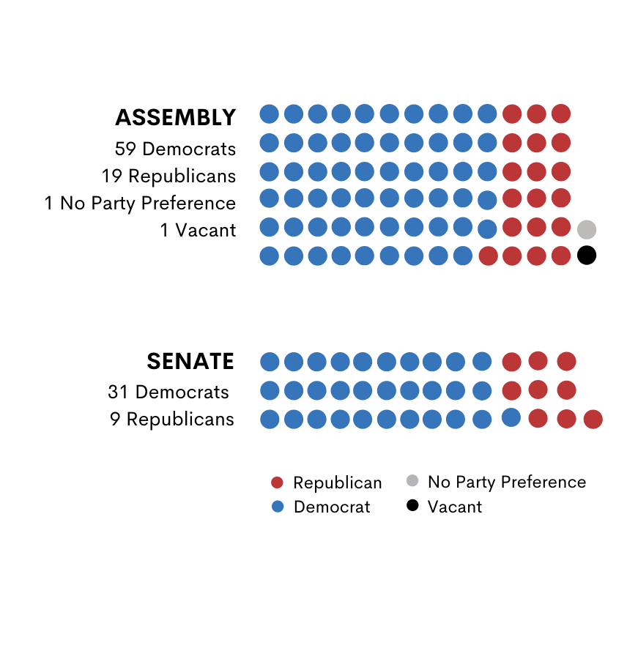
Legislative Landscape
Democrats dominate both the Senate and Assembly
Based on term limits there will be 38% changeover in the Legislature by 2024
With new representatives, legislative leadership, and committee chairs, it is essential to maintain ongoing lobbying, CASA grassroots outreach, and a robust PAC

Slide 5
Key Priorities for Legislative Outreach
CASA PAC funds support elected officials who understand and help champion our industry’s viewpoint on policy areas including:
Physician ownership
Fair reimbursement and new policies on value-based care
Procedures approved for the ASC setting
Single payer proposals
Out of network options
Oversight, reporting and licensure issues
Protecting
MICRA
Rules on mergers and acquisitions

Slide 6
Powerful Political Interests are Actively Opposing ASCs
SEIU Letter to the CA Legislature – April 5, 2021
“ASCs, with their lack of reporting, insufficient regulatory oversight, and the potential for perverse financial incentives, create unnecessary risks for patients.
Most ASCs are not licensed in California and are covered by a patchwork of private accreditors who oversee the physician-owned ASCs. California is one of the few states that has given private accreditors a lead role in reviewing clinics’ policies and procedures, creating a troubling lack of oversight and regulation, which has jeopardized patient safety. Given this lack of oversight, it is inappropriate to give additional responsibilities to ASCs without first ensuring that patients will be as safe as they would have been receiving the same procedure in a hospital. . .
Many ASCs in California are partially or wholly owned by physicians who may refer patients to their own facility. While the physician is required to disclose this financial relationship to patients, that disclosure is not adequate to ensure the patient is given care in the appropriate setting. Prohibiting a physician from referring a patient to an ASC where they have [finical] interest, would help erect guardrails on patient referrals and ensure that patients are getting the right care in the right setting, without outside financial influences.”

Slide 7
Comparing the Numbers– Cash on Hand
$12,500,000
$10,000,000
$7,500,000
$5,000,000
$2,500,000
0
CA Hospital Assoc
CA Medical Association
CA Ortho Association
CASA
CSA
SEIU
CA Assoc of
Health Facilities (SNFs)

Slide 8
Rules on Contributions
Donations can come from the surgery center, corporate parent, or individual physicians and ASC employees. There are no restrictions on the entities that can contribute to the CASA PAC.
Maximum contribution per year is $8,100.
Contributions are not tax deductible.

Slide 9
How to Participate
1
2
3
Questions? Contact:
Beth LaBouyer
CASA Executive Director
(530) 790-7990
info@casurgery.org
Checks should be made payable to CASA PAC and should be mailed to:
Call the CASA office to pay with a credit card:
(530) 790-7990
CASA PAC
1127 11th Street, Suite 210
Sacramento, CA 95814

